Slide 1

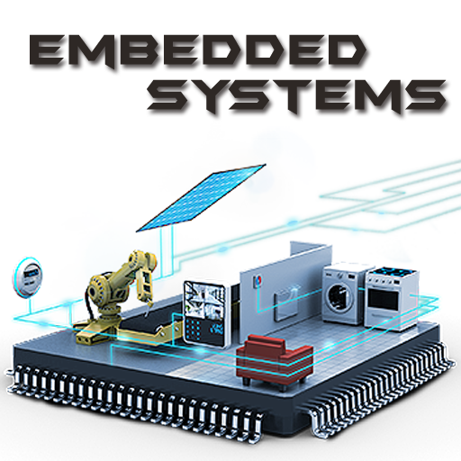
Graduation project electric water heater
Presented by:
ENG/Omar Mohamed
ENG/Youssef Ashraf
ENG/abdelrahman ahmed

Slide 2
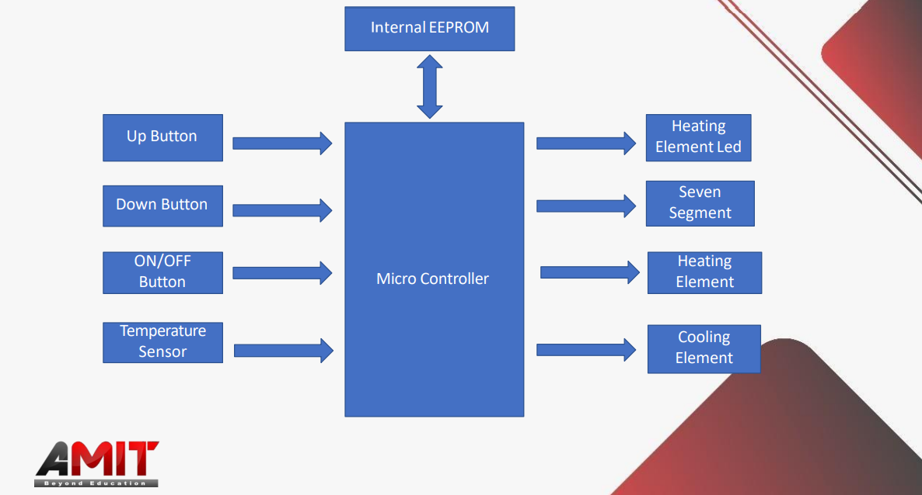
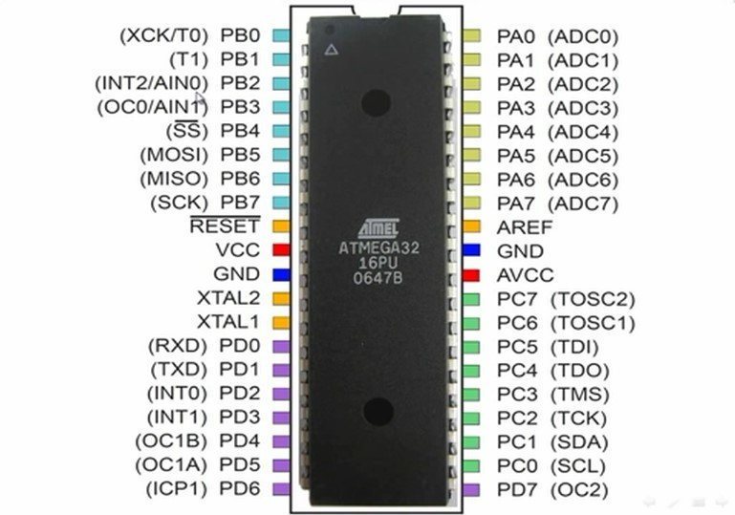
Introduction
COMPONENTS
MICROCONTROLLER (ATMEGA32)

Slide 3
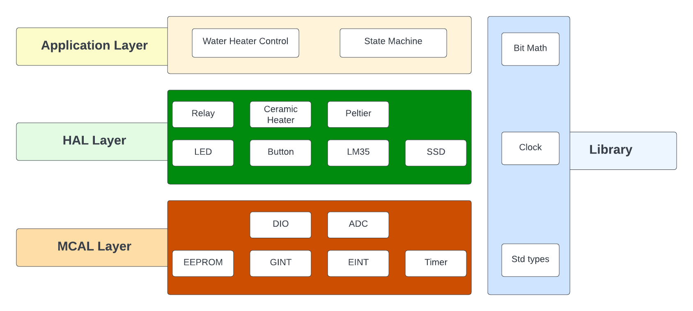
LAYERED ARCHITECTURE

Slide 4
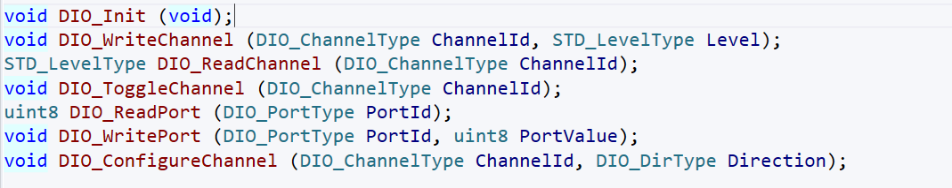
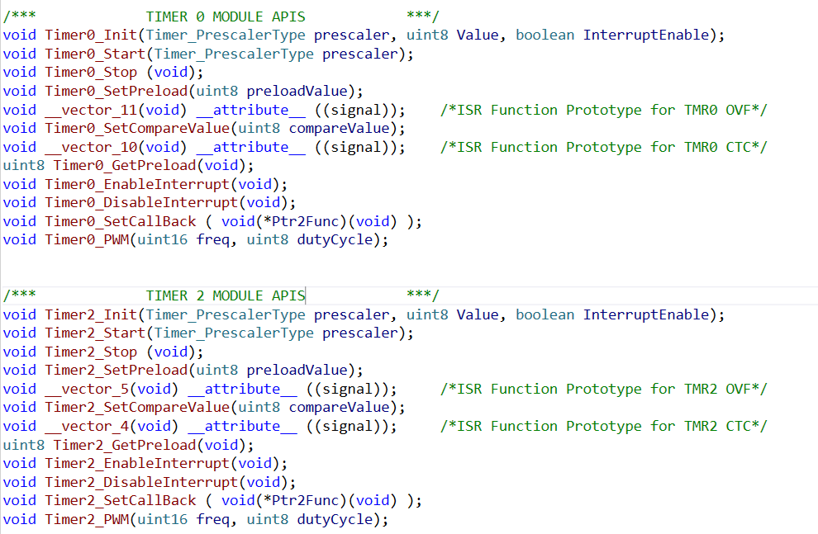



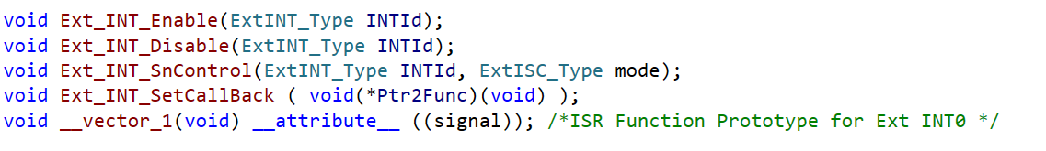
Modules api specification – Microcontroller abstraction layer
DIO: • Timer:
ADC:
EEPROM: • GINT:
• EINT:

Slide 5


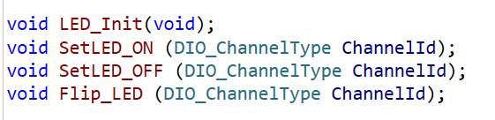


Modules api specification – HARDWARE abstraction layer
Button: LM35:
LED: Ceramic Heater:
SSD: Peltier:
Relay:

Slide 6

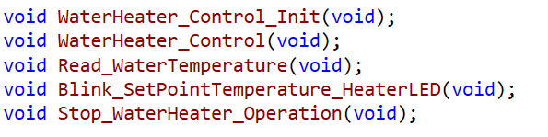
Modules api specification – application layer
STATE MACHINE:
WATER HEATER CONTROL:

Slide 7
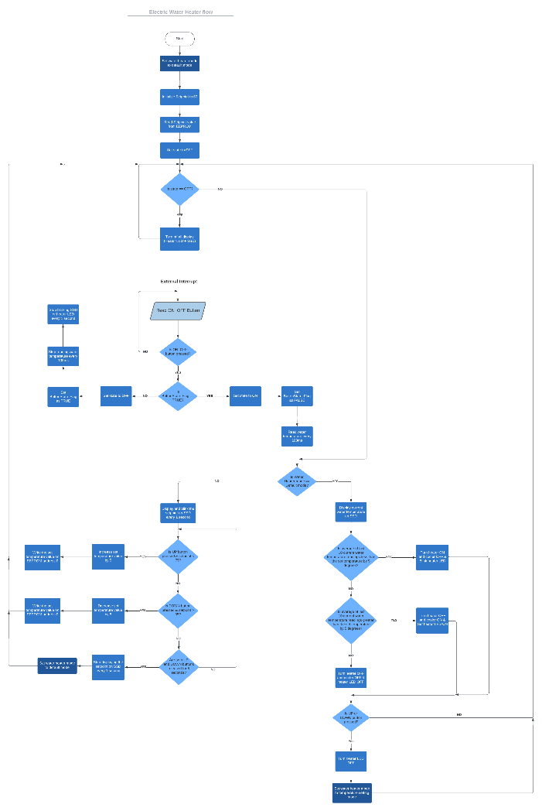
Operating flow chart Diagram

Slide 8
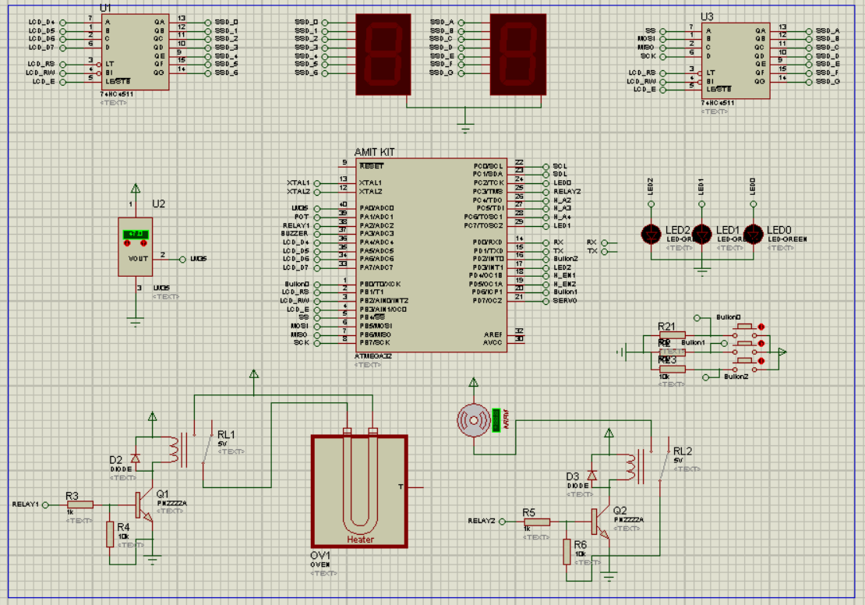
project LAYOUT

Slide 9
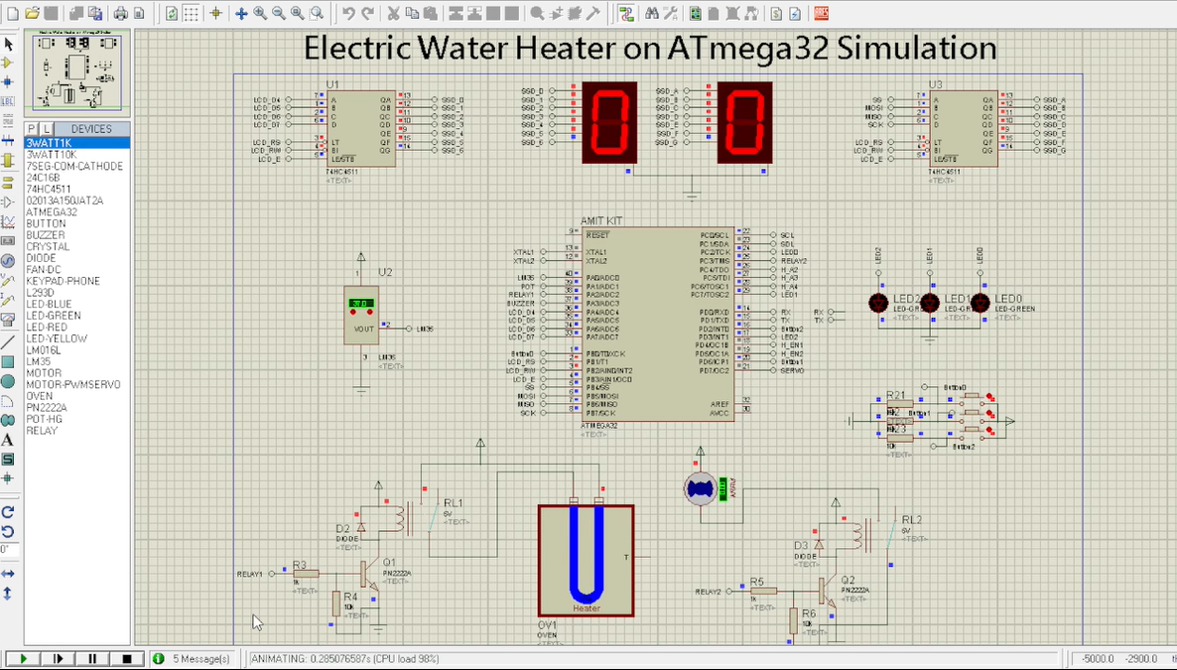
SIMULATION

Slide 10
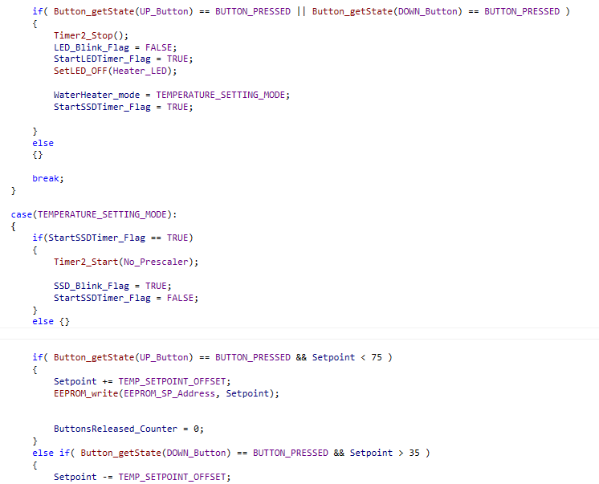
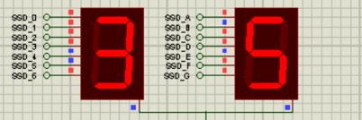
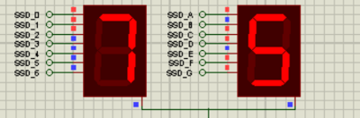
Problems encountered
Button Debouncing and Invalid Set Temperature Modification

Slide 11
ANY QUESTIONS…?

Slide 12
THANK YOU!

